Slide 1
Microsoft Power BI

Slide 2
Developing for Power BI using Azure Functions
Ted Pattison
Principal Program Manager
Power BI Customer Advisory Team (PBICAT)

Slide 3
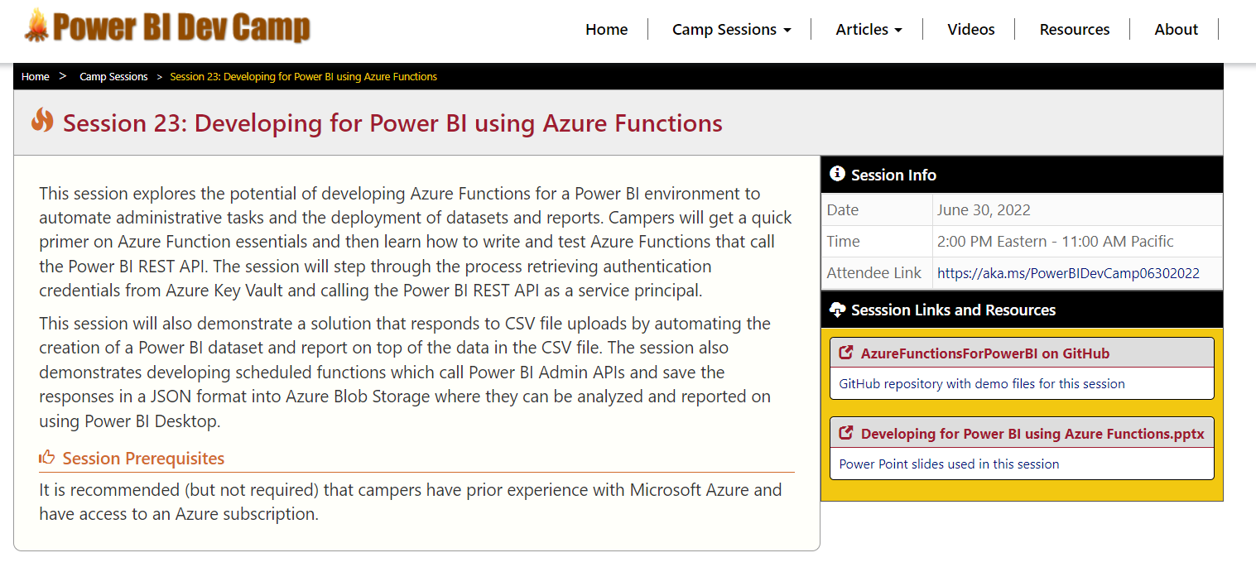
Welcome to Power BI Dev Camp
Power BI Dev Camp Portal - https://powerbidevcamp.net

Slide 4
GitHub Repository: AzureFunctionsForPowerBI
Demo code from this session available in public GitHub repository
https://github.com/PowerBiDevCamp/AzureFunctionsForPowerBI

Slide 5
Agenda
Azure Functions Primer
Calling the Power BI REST API
Writing Data Files into Azure Storage
Automating Report Creation on File Upload
Developing an SPA using Azure Functions

Slide 6
Azure Functions – Essential Concepts
Motivation for creating Azure functions
Serverless, event-driven programming model
No friction to setup & manage servers
Azure function == [code + config]
Azure functions designed using configurable triggers and bindings
Function triggers provide mechanism to start function execution
Function bindings provides easy access to Azure services like blob storage
You have choice in programming language and development environment
Choose between C#, Java, JavaScript, PowerShell, F# and Python
Developers can use familiar tools (Visual Studio 2022, Visual Studio Code)
This session will demonstrate using C# and Visual Studio 2022

Slide 7
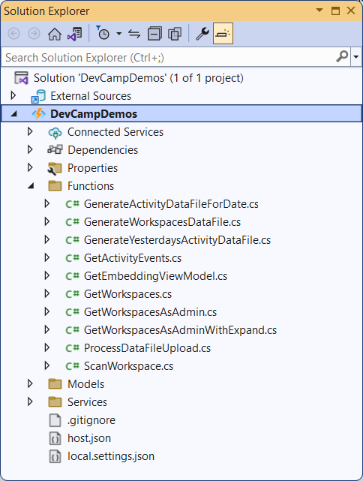
Function Apps and Function App Projects
Azure functions are developed and deployed using Function Apps
Function app provides execution context for all its functions
Function App provides project scope for Azure Function development
Function app defines pricing plan, deployment method, and runtime version
All functions in a Function App must be written in same language (recent restriction)
In C#, each Azure function maintained in separate class file

Slide 8
Azure Function Provides Run Method for Execution
Every Azure Function provides Run method
Run method is executed when trigger by Azure Function runtime

Slide 9
Function Triggers Defined in C# using Attributes
Run method execution started using a trigger
HTTPTrigger executes function in response to HTTP request
TimerTrigger executes function at periodic time interval
BlobTrigger executes function in response to file upload to Azure storage container

Slide 10
Function Bindings Defined in C# using Attributes
Bindings defined as parameters in Run method after trigger parameter
Bindings provide Azure Function with seamless access to Azure services such as Blob storage
Bindings can be defined as input parameters and/or output parameters
Examples of using bindings to access files in blob storage
Blob bindings parameter defined as input parameter with Read access
Blob bindings parameter defined as output parameters with Write access

Slide 11
Azure Resources Used in Demos for This Session
Function app
Runs on top of App Service plan
Key vault
Used to store secrets
Azure storage account
Used to write and read files

Slide 12
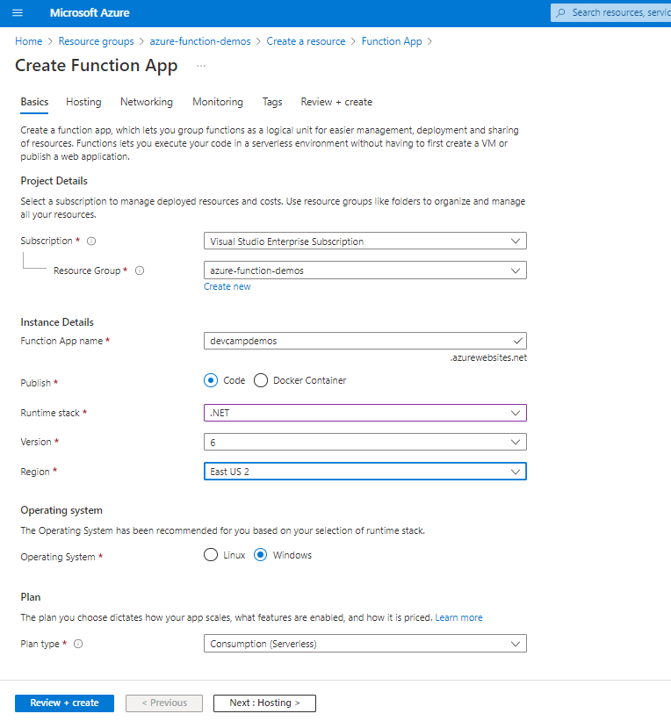
Creating a New Function App in the Azure Portal

Slide 13
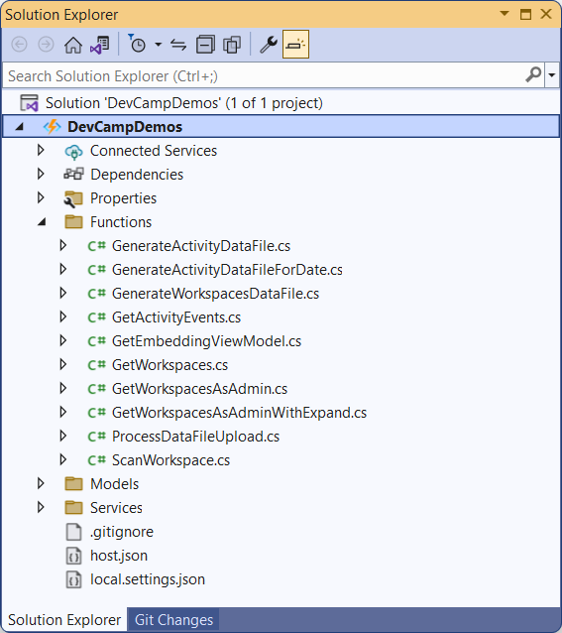
Creating a Function App Project in Visual Studio 2022

Slide 14
Publishing an Azure Function App Project
Azure Function project in Visual Studio provides Publish command
Publish command can be configured to deploy project to Azure Function App

Slide 15
Agenda
Azure Functions Primer
Calling the Power BI REST API
Writing Data Files into Azure Storage
Automating Report Creation on File Upload
Developing an SPA using Azure Functions

Slide 16
What Is the Power BI REST API?
What is the Power BI REST API?
API built on OAuth2, OpenID Connect, REST and ODATA
API secured by Azure Active Directory (AAD)
API to program with workspaces, datasets, reports & dashboards
API which can be programmed using C# and the Power BI .NET SDK
What can you do with the Power BI REST API?
Retrieve data about workspace inventory and activity events
Create workspaces and manage workspace membership
Publish reports and datasets by importing PBIX project files
Update connection details and datasource credentials
Embed Power BI reports and dashboards tiles in web pages

Slide 17
User APIs versus Admin APIs
Power BI User APIs (e.g. GetGroupsAsync)
provides users with access to personal workspace
provides users with access to app workspaces
provides service principal (SP) with access to app workspaces
Power BI Admin APIs (e.g. GetGroupsAsAdminAsync)
provides users with tenant-level access to all workspaces

Slide 18
Authenticating as Service Principal with Azure AD
Custom applications must authenticate with Azure AD
You code must acquire access token before calling Power BI REST API
Your code must implement client credentials flow to acquire access token
Requires authentication credentials for TenantId, AppId and AppSecret
Azure Active Directory
Azure AD Application
Custom App
Access Token
Access Token
Power BI REST API

Slide 19
Power BI API Authorization for Service Principals
Service Principal used to configure access control
Requires the use of v2 app workspaces
Access control NOT based on Azure AD permissions
Service principal access configured using Power BI Tenant Admin settings
Service principal must be added as workspace member for User APIs
App Workspace 1
Admins
User 1
User 2
App 1 Service Principal
Power BI Service
App 1 Service Principal
App-only Access Token
App Workspace 2
Admins
User 1
App 1 Service Principal
App 2 Service Principal

Slide 20
Configuring Service Principals to Use User APIs

Slide 21
Configuring Service Principals to Use Admin APIs

Slide 22
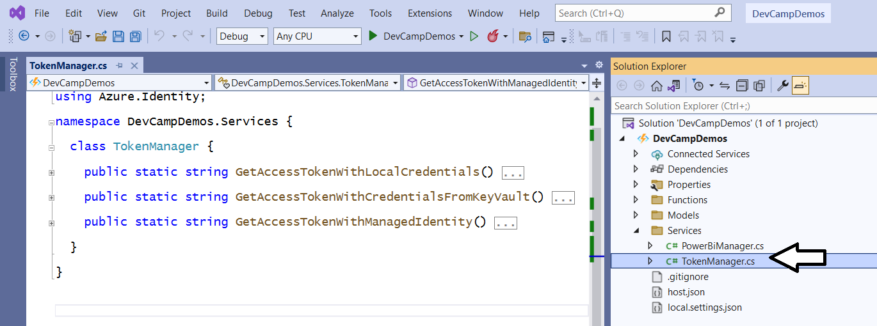
TokenManager Class Implements Client Credentials Flow
DevCampDemos shows three ways to get access token for service principal
Get Access Token with Local Credentials
Get Access Token with Credentials from Azure Key Vault
Get Access Token with Managed Identity

Slide 23
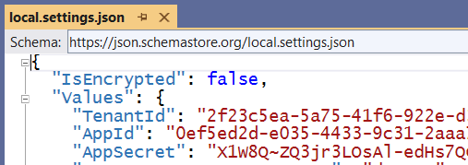
GetAccessTokenWithLocalCredentials
Step 1 – Add TenantId, AppId and AppSecret as AppSettings
Can be added to local.settings.json during development and testing
Step 2 – Retrieve AppSettings in code and then execute client credentials flow

Slide 24
Storing Secrets in Azure Key Vault
Azure Key Vault provides secure container to keeping secrets
Azure key vault instance created using Azure subscription
Azure Function App should access Azure key vault using managed identity

Slide 25
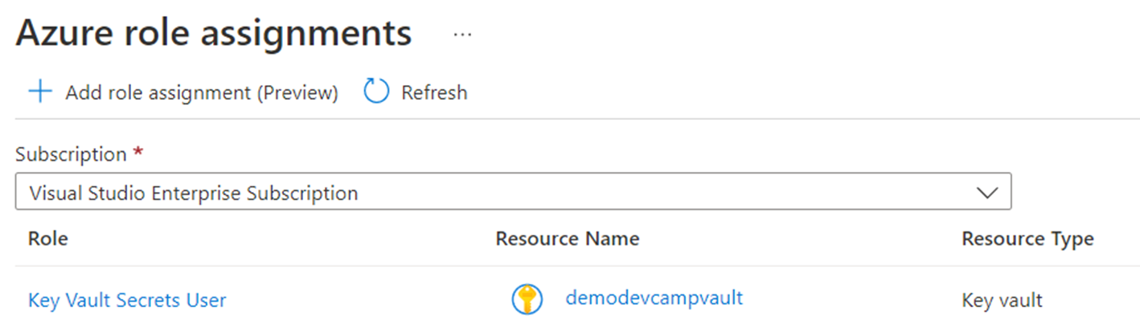
Configuring Managed Identity for a Function App

Slide 26
GetAccessTokenWithCredentialsFromKeyVault

Slide 27
GetAccessTokenWithManagedIdentity
You can authenticate with managed identity to directly acquire Power BI access token
Eliminates need to create, manage and secure AppSecret
System-assigned managed identity is visible to Power BI just like other service principals
System-assigned identity can be added as member to Azure AD group (e.g. Power BI Apps)
System-assigned identity can be added as workspace member

Slide 28
Initializing an Instance of PowerBIClient
PowerBIClient object serves as top-level object in Power BI.NET SDK
Used to execute API calls against Power BI Service
Initialized with API root URI and AAD access token added as Bearer token

Slide 29
Example of User API versus Admin API
GetGroupsAsync is a User API call
API returns all workspaces in which service principal is a member
GetGroupsAsAdminAsync is an Admin API call
API (potentially) returns all workspaces in current Azure AD tenant

Slide 30
PowerBiManager.GetWorkspacesAsAdminWithExpand
Calls GetGroupsAsAdminAsync using filter and expand parameters

Slide 31
Agenda
Azure Functions Primer
Calling the Power BI REST API
Writing Data Files into Azure Storage
Automating Report Creation on File Upload
Developing an SPA using Azure Functions

Slide 32
Next Demo Inspired by Rui Romano and pbimonitor
pbimonitor available at https://github.com/RuiRomano/pbimonitor

Slide 33
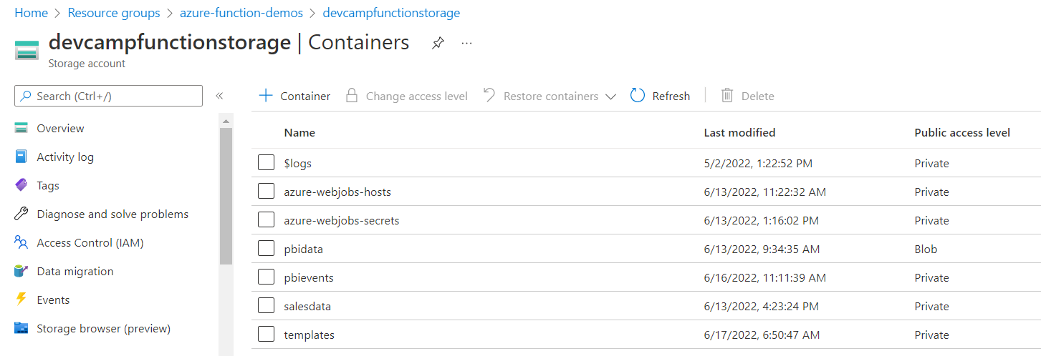
Azure Storage Accounts

Slide 34
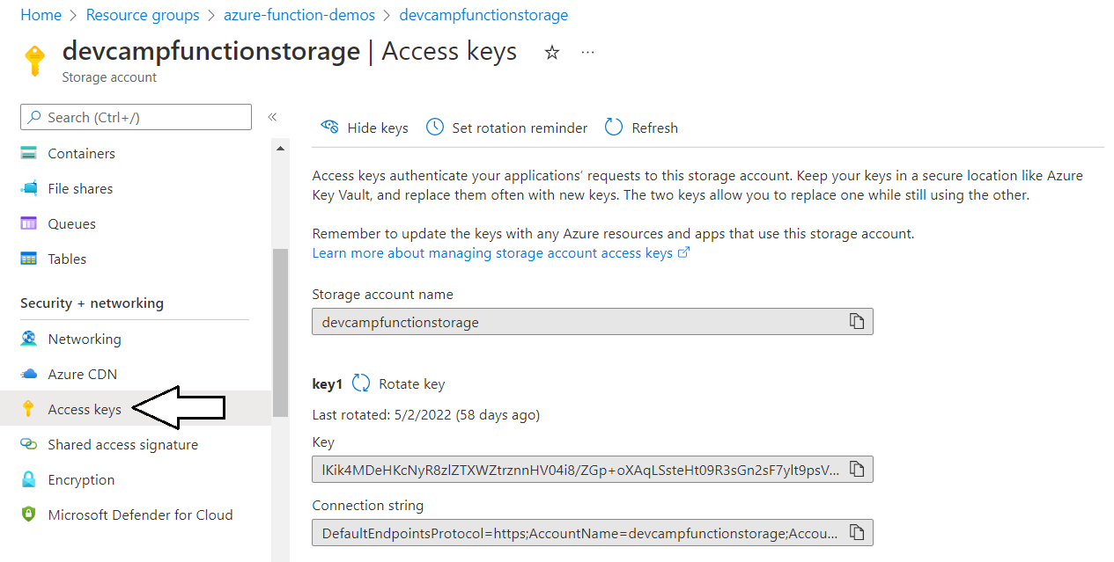
Storage Account Access Keys
Access Key by itself
Access Key embedded in connection string

Slide 35
GenerateWorkspaceDataFile
GenerateWorkspaceDataFile designed with TimerTrigger
Includes CRON expression in trigger attribute to execute function once a day at 6:30 AM
Binding parameter with Blob attribute provides easy access to newly created file
File contents written to blob storage using .NET TextWriter class

Slide 36
GenerateYesterdaysActivityFile
Connect to Azure blob storage using BlobContainerClient
Required if file name must be created dynamically

Slide 37
Extracting Event Activity Data using Power BI REST API

Slide 38
Agenda
Azure Functions Primer
Calling the Power BI REST API
Writing Data Files into Azure Storage
Automating Report Creation on File Upload
Developing an SPA using Azure Functions

Slide 39
ProcessDataFileUpload
Example of Azure function with trigger and binding
BlobTrigger used to execute function whenever file is uploaded to container
Blob binding attribute used to configure read-only access to PBIX template file

Slide 40
ProcessFileUpload

Slide 41
PublishPBIX and PatchBlobStorageCredentials

Slide 42
Agenda
Azure Functions Primer
Calling the Power BI REST API
Writing Data Files into Azure Storage
Automating Report Creation on File Upload
Developing an SPA using Azure Functions

Slide 43
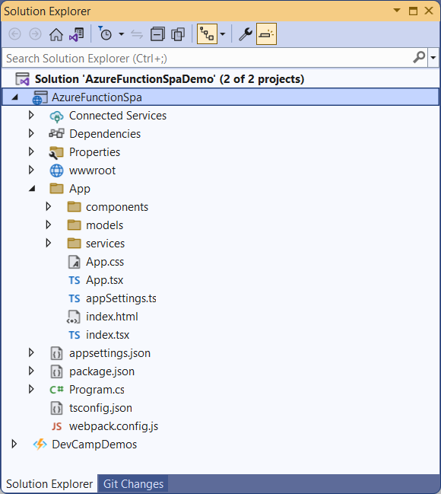
Demo: AzureFunctionSpaDemo
Simple proof of concept (POC) app
Created with React.js and TypeScript
Demonstrates how to build SPA which calls Web API built using Azure Function app

Slide 44
Configuring CORS for an Azure Function App

Slide 45
Securing SPA Access to Azure Functions
Securing Functions in an Azure Function App
Anonymous access
Function level access code
Admin/Global level access code
Configure Function App to use Azure AD Application

Slide 46
Summary
Azure Functions Primer
Calling the Power BI REST API
Writing Data Files into Azure Storage
Automating Report Creation on File Upload
Developing an SPA using Azure Functions

Slide 47
Microsoft Power BI
Questions?

